Slide 1
The Historical Frame of The Princess of Cleves
What difference does the history make to the novel?

Slide 2
Henry II of France and the Queen, Catherine de Medici
Notes:
Henry II: 2nd son of the great Francois I (the great unifier of France and patron of the arts
Catherine comes from the greatest family of Florence… but becomes an imperious difficult woman

Slide 3
Duchess of Valentinois, or, Diane de Poitiers
Notes:
Poitier is a power in Francis I court… the famous portrait on the right shows her as a royal mistress, who seduces the 2nd son and is the greatest power of the court of Henry II

Slide 4
Mary Stewart, the Queen Dauphine Queen of Scotland and then France

Slide 5
Queen Elizabeth and the Duke de Nemours
Notes:
Here is the coronation portrait of 1658—talk about being armored!

Slide 6
The Princess de Cleves is an invention… There is an Anne of Cleves (1515-1557), 4th wife of Henry VIII

Slide 7
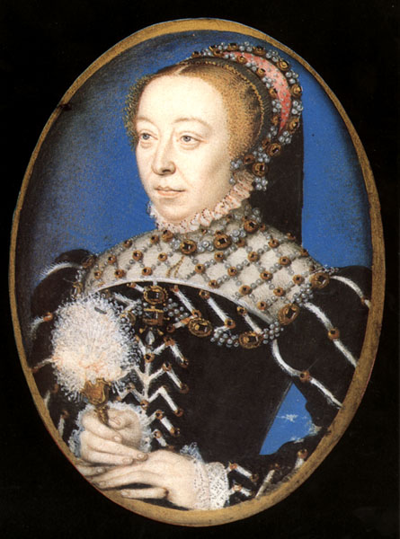
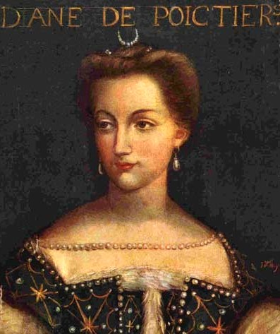
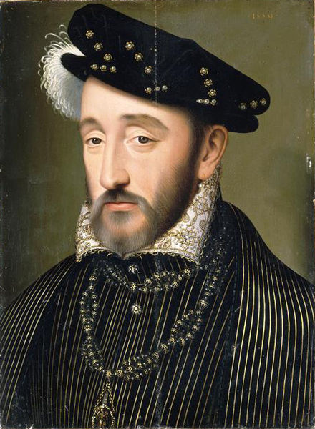
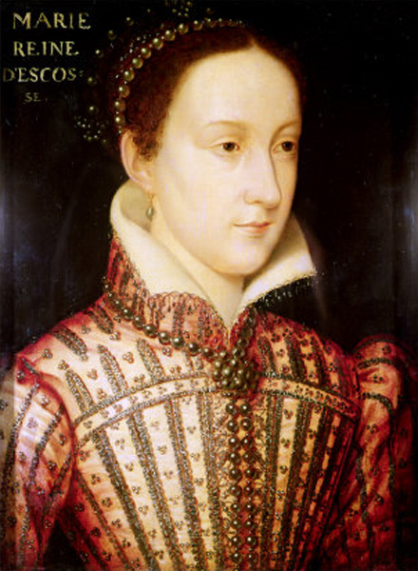
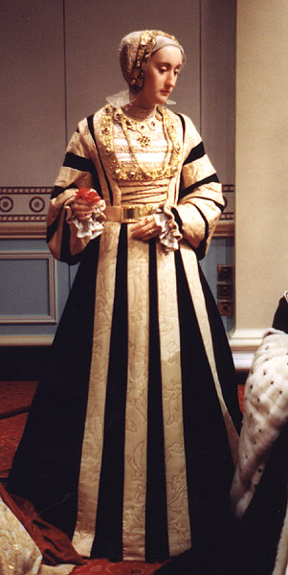
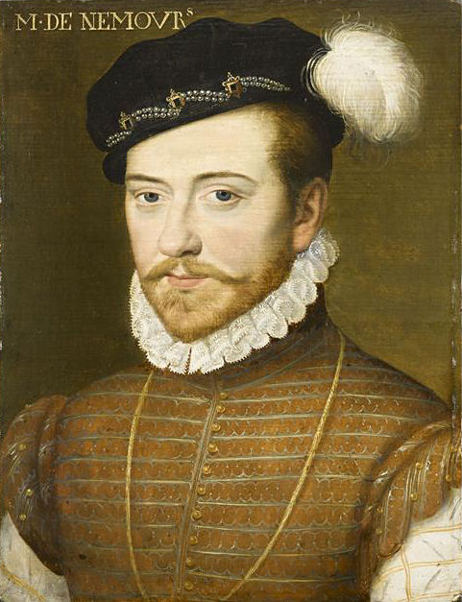

Slide 8
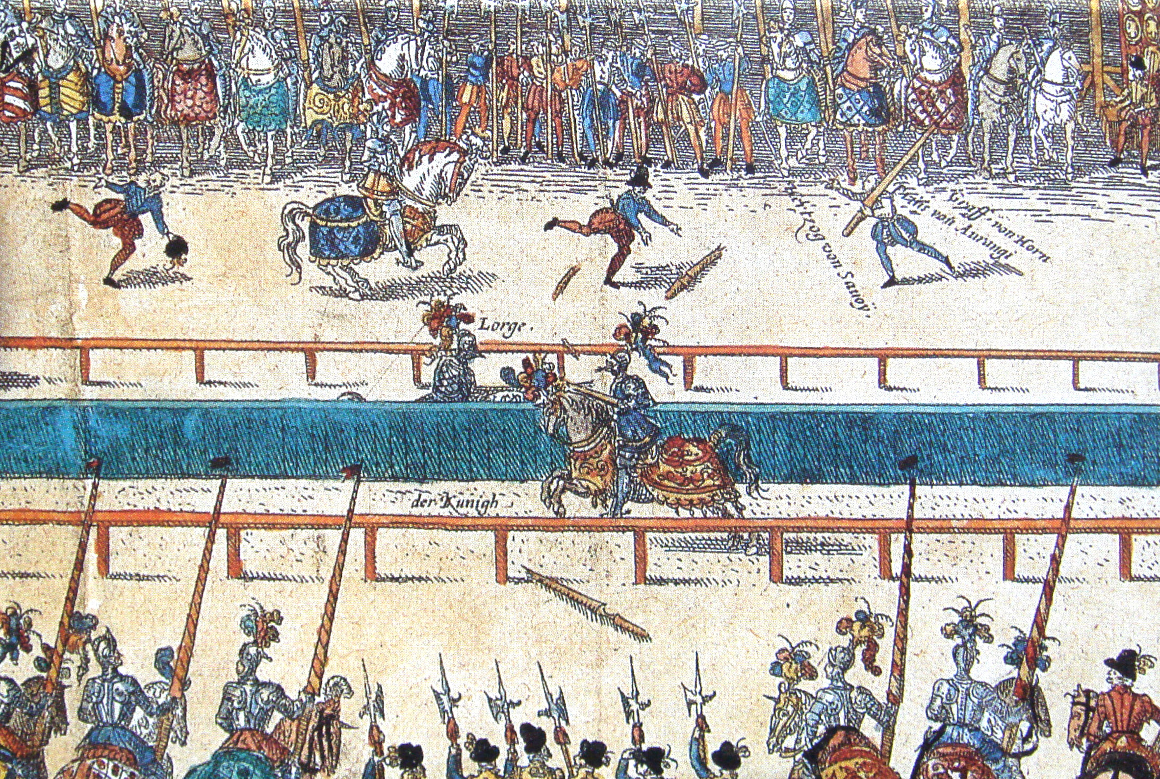
30 June 1559: the Tournament where Henry II is killed
Notes:
At the center of the novel is a tragic accident: how does this affect the novel?
What difference does this historical framing make to the novel?

